Slide 1
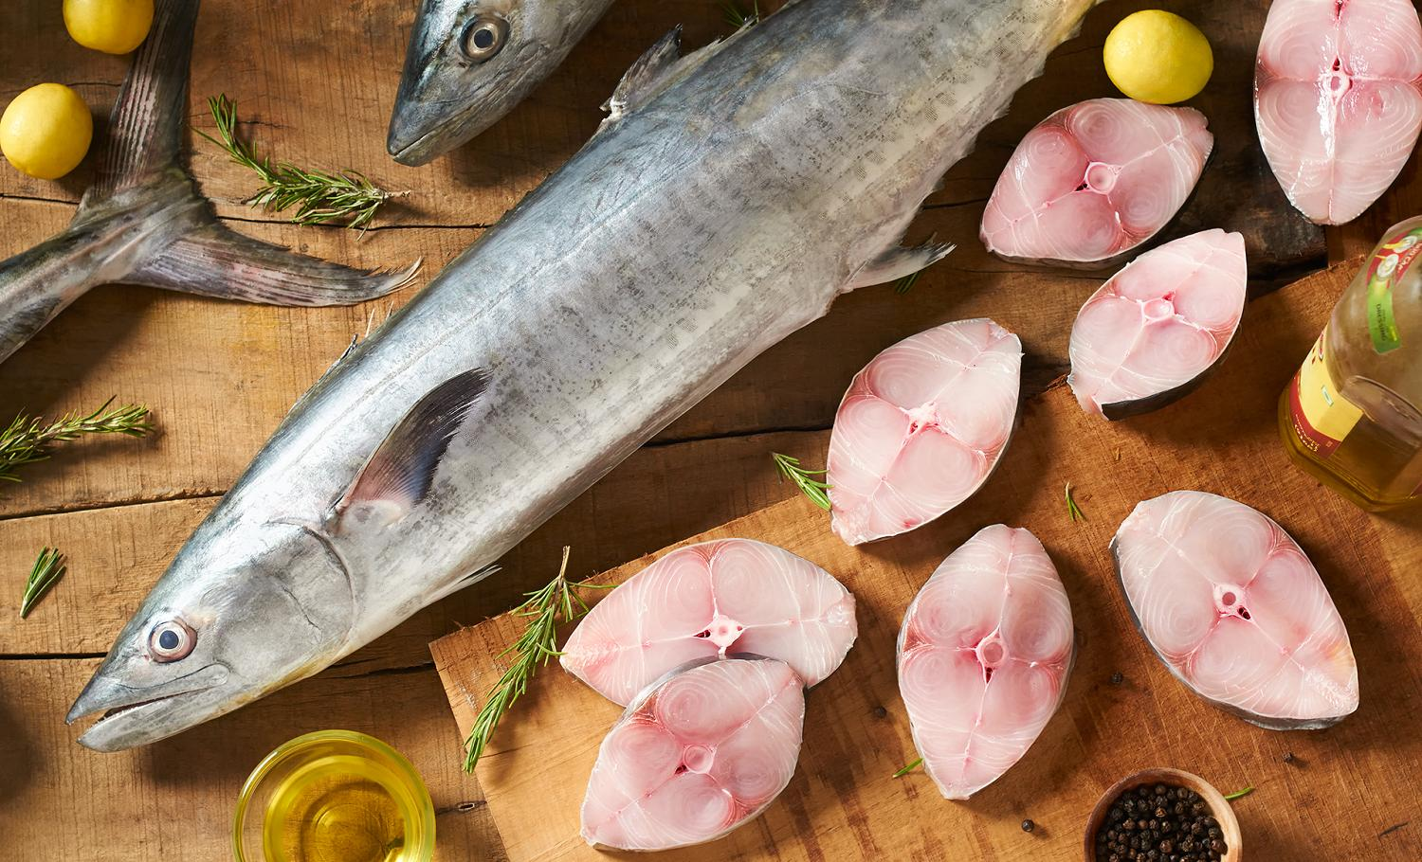
20% OFF
4 kg – 5 kg. Per Fish Size

