Slide 1
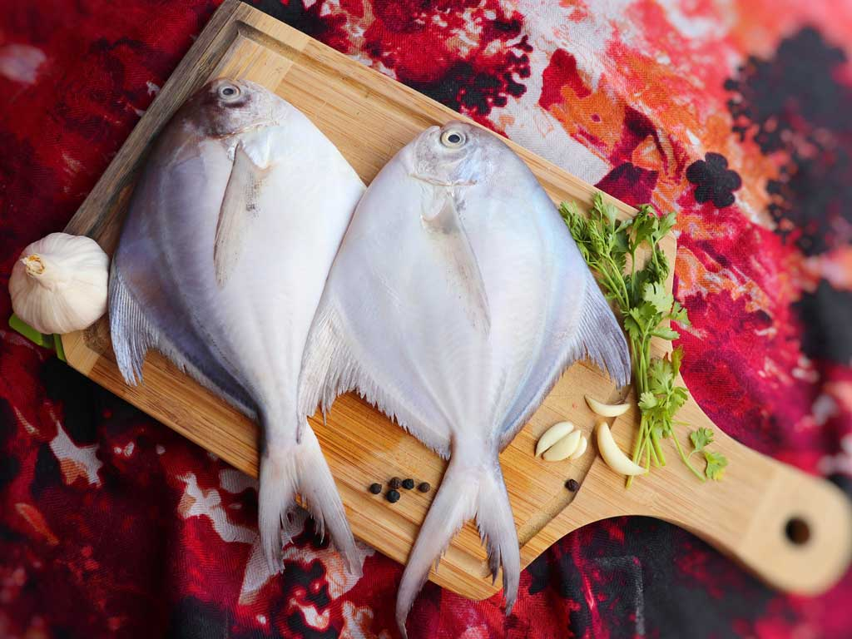
80 – 100 Gm Per Fish

